Slide 1

Data Science’s First Classifier: The Perceptron
By: Molo Munyansanga
University of Kigali • Data Science Conference • 23/06/2025

Slide 2
What Is Classification in Data Science?
Classification is the task of assigning labels to data points based on input features.
It is a core part of supervised machine learning.
Common real-world applications:
Email → Spam or Not Spam
Image → Cat, Dog, or Other
Medical data → Diseased or Healthy
In data science, classification helps automate decision-making using patterns learned from historical data.

Slide 3
The Birth of the Perceptron (1957, Rosenblatt)
Invented by Frank Rosenblatt in 1957.
Designed to simulate a biological neuron for pattern recognition.
The first algorithm that could learn to classify data by adjusting weights.
Considered the first trainable neural network to be implemented.
Initially used for basic visual pattern classification.

Slide 4
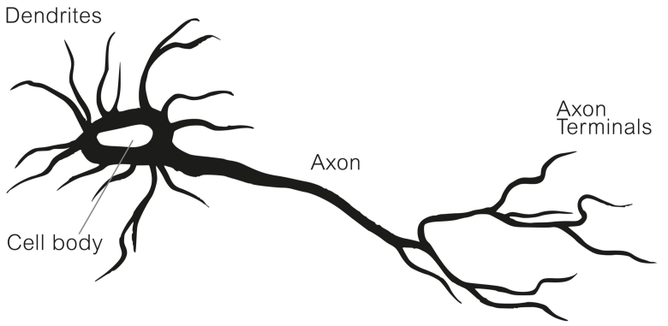
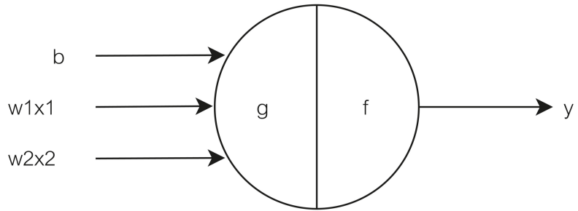
How the Perceptron Works

Slide 5
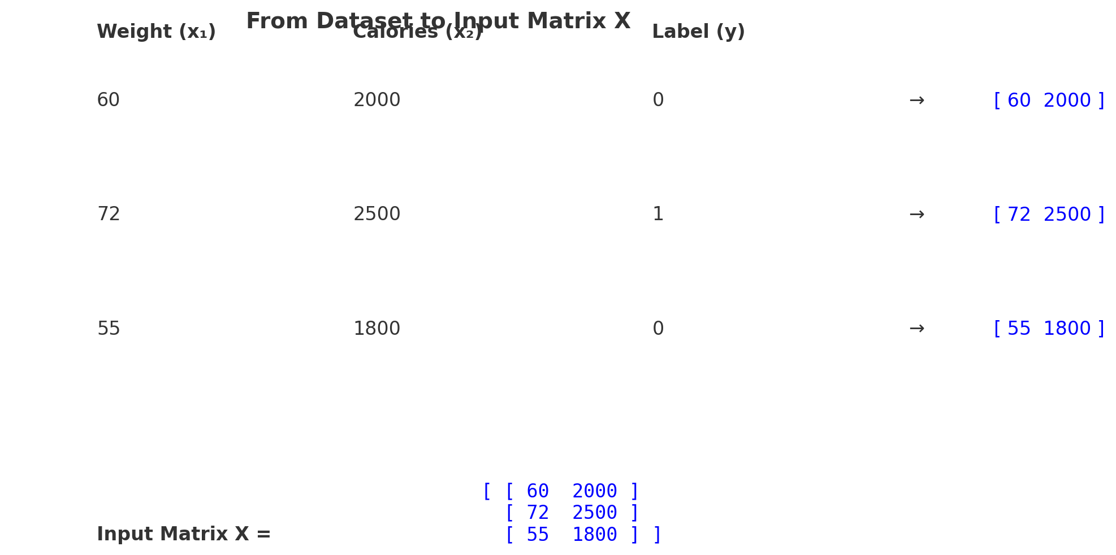
How to feed Data to the Perceptron
Weight (x1) | Calories (x2) | Risk (y)
60 | 2000 | -1
72 | 2500 | 1
55 | 1800 | -1
Input Matrix, x =

Slide 6
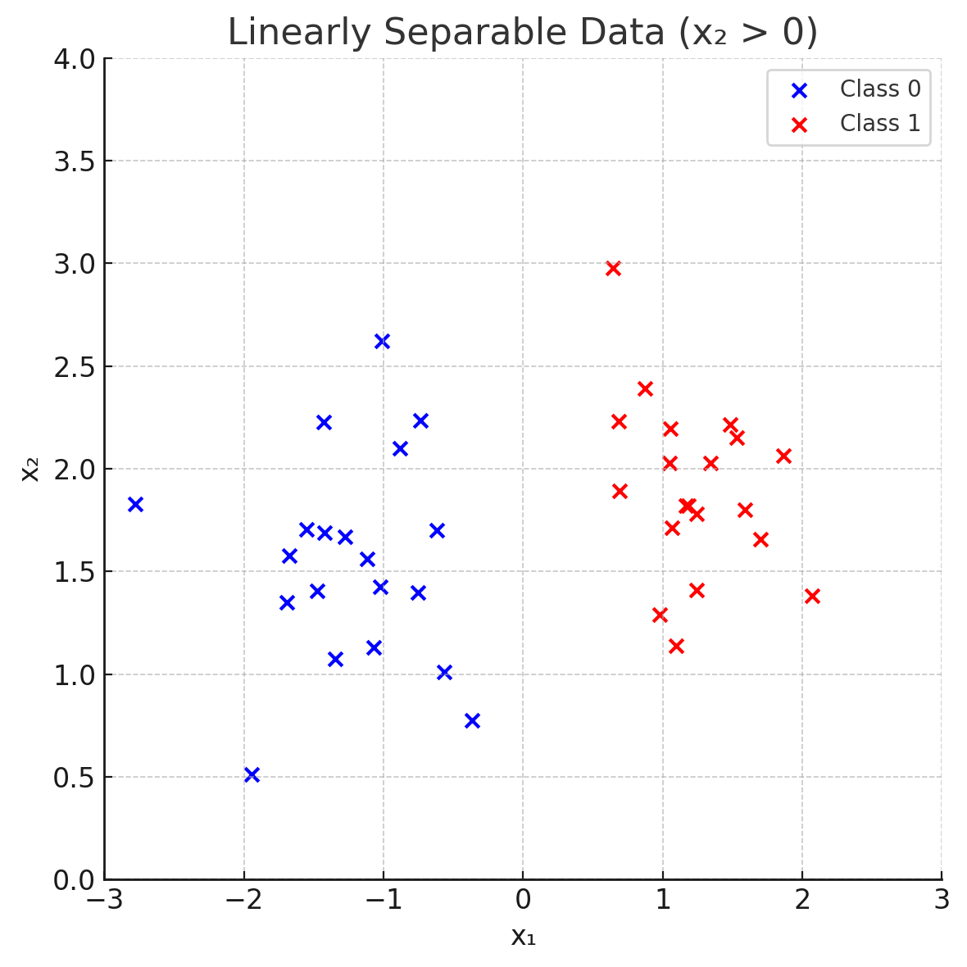
Understanding Weights and Biases
Increase bias
Increase bias again
Increase w1
Increase w2

Slide 7
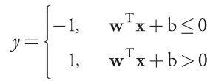
Learning in the Perceptron
Make a prediction
Compare it to the true label
If wrong, adjust weights to reduce the error
Repeat across the dataset

Slide 8
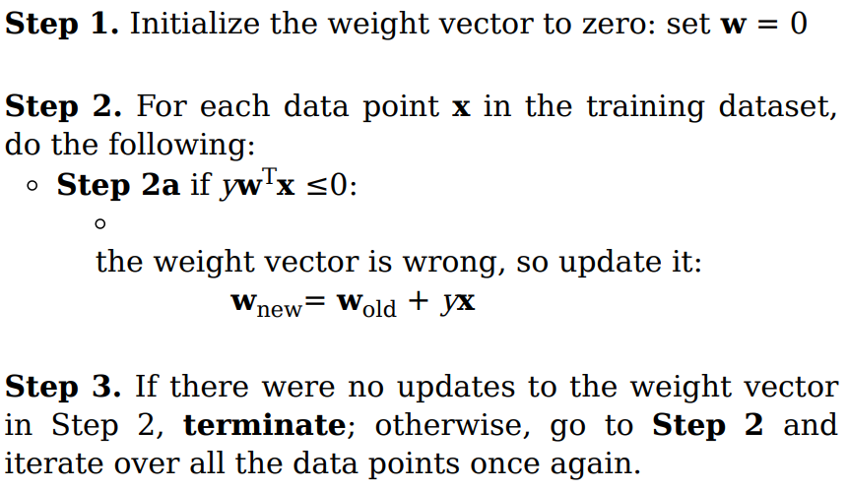
The Algorithm (Conceptual)
Step 1. Initialize the weight vector to zero: set w = 0
Step 2. For each data point x in the training dataset, do the following:
Step 2a if yw^{T}x ≤0:
the weight vector is wrong, so update it:
wnew= wold + yx
Step 3. If there were no updates to the weight vector
in Step 2, terminate; otherwise, go to Step 2 and
iterate over all the data points once again.

Slide 9
Limitations of the Perceptron
Only works for linearly separable data.
Single-layer structure.
No learning if data is not separable

Slide 10
How Modern ML Models Overcome These Limits
Multilayer Perceptron (MLP):
Adds hidden layers to handle complex patterns.
Backpropagation algorithm:
Enables training of deep neural networks by updating weights layer by layer.
Alternative models for classification:
Logistic Regression, Support Vector Machines, Decision Trees & Random Forests

Slide 11
Why This Still Matters in Data Science
Foundational concept: Introduced key ideas—weights, bias, activation—that are core to modern models.
Builds intuition: Helps data scientists understand how models learn from data.
Model transparency: Simple structure makes it ideal for teaching, prototyping, and debugging.

Slide 12
Summary
Classification is a core task in data science — assigning labels to data.
The Perceptron (1957) was the first model to learn from labeled data.
It introduced key ML concepts: weights, bias
It had limitations — couldn’t handle non-linear problems.
Modern models build on its foundations.
Understanding the Perceptron = understanding the roots of intelligent systems.

Slide 13
Recommended Reading
Why Machines Learn – The Elegant Math Behind Modern AI
By: Anil Ananthaswamy

Slide 14
Questions and Answers (Q&A)

